Slide 1
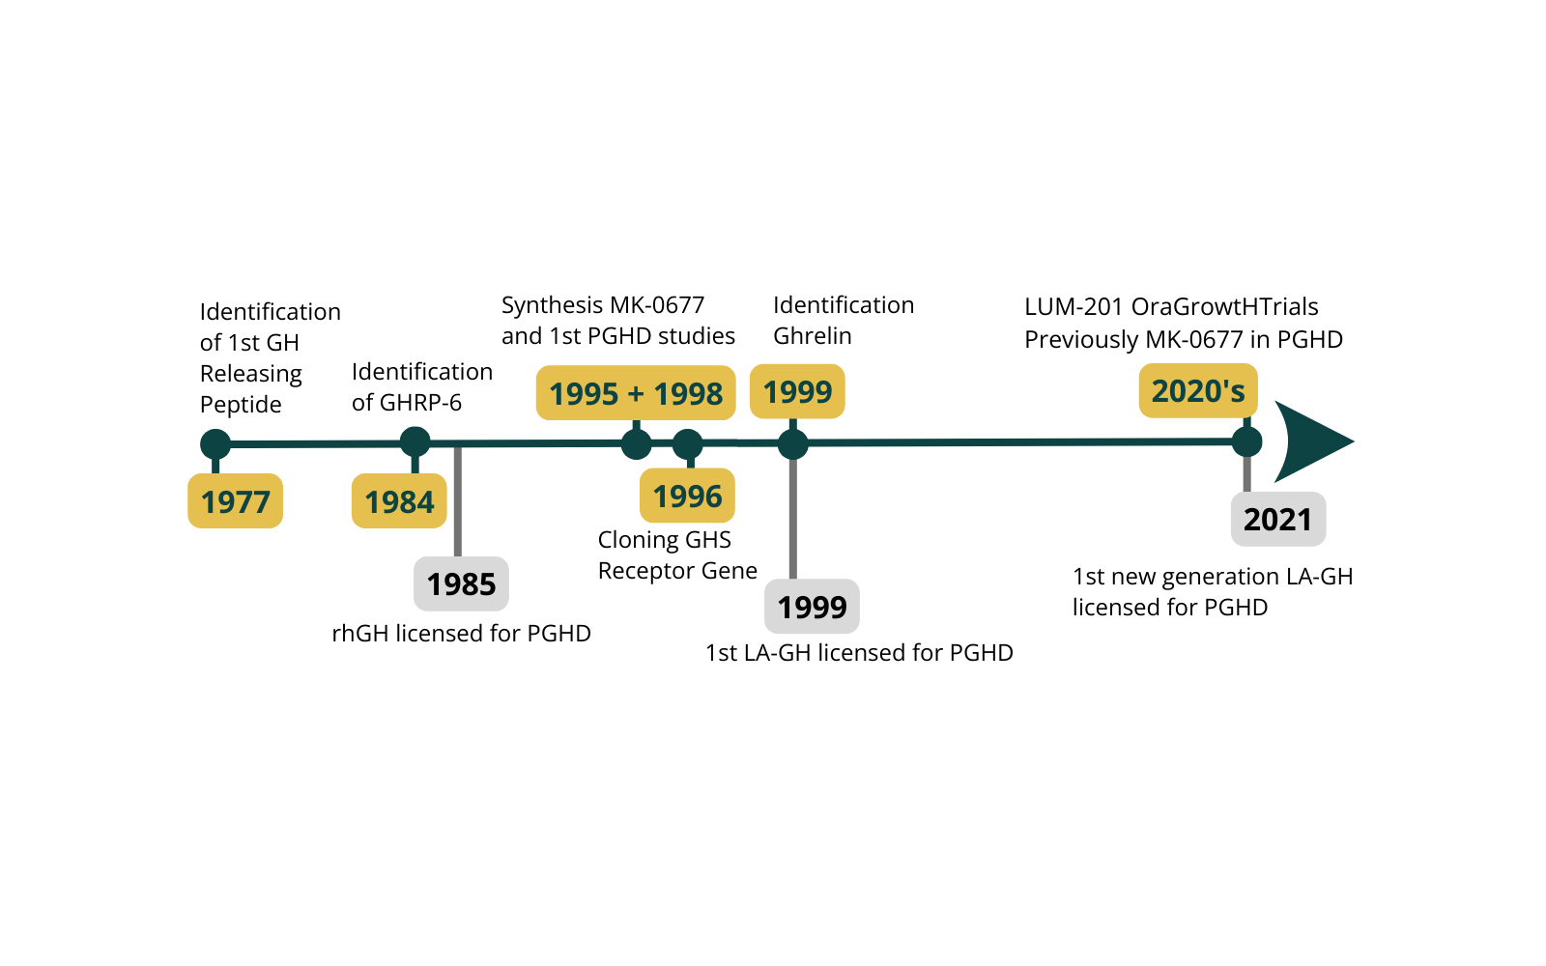


Approaching the Reality of Restoring GH Secretion and Growth with the Investigative Oral Growth Hormone Secretagogue (GHS) LUM-201 in Moderate Paediatric Growth Hormone Deficiency (PGHD)
Timeline* for key events in the development of GH Secretagogues and rhGH in PGHD
Is restoring physiological GH secretion a better approach to treating moderate paediatric GHD than using exogenous rhGH?
*dates refer to publications, FDA reports,etc
Peter Clayton
Paediatric Endocrinology
University of Manchester
10th GRS Conference May 2024 Stockholm, Sweden

Slide 2
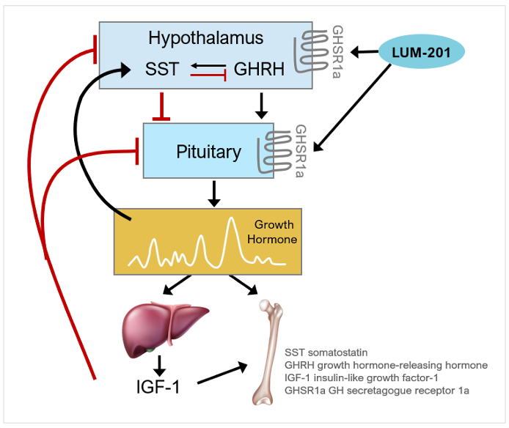
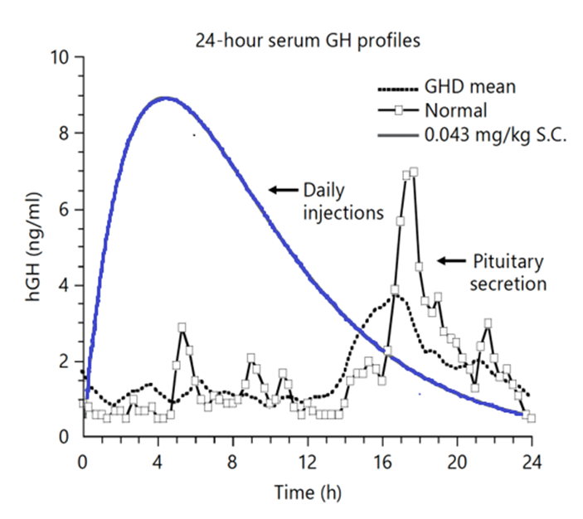
LUM-201 Stimulates Endogenous GH Secretion
LUM-201 is an oral growth hormone (GH) secretagogue
Targeted to those with moderate GH deficiency, and identified by a Predictive Enrichment Marker (PEM) test:
PEM Positive Responders ¹
Baseline IGF-1 > 30 ng/ml
Stimulation LUM-201 0.8mg/kg peak GH ≥ 5 ng/ml
Functional but reduced HP-GH axis
Bright 2021 JES
Figure ‘Long-Acting Growth Hormone: An Update’ Paul H. Saenger & Jorge Mejia-Corletto In: Advanced Therapies in Pediatric Endocrinology and Diabetology. Endocr Dev. Basel, Karger, 2016, vol 30, pp 79–97

Slide 3
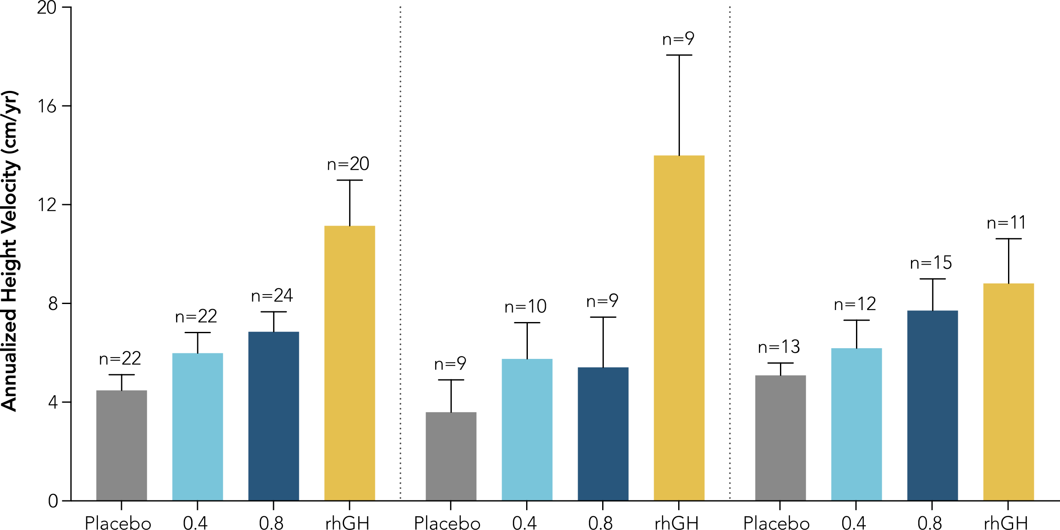
Merck Study 020 Post-Hoc Analysis:
PEM-Positive Patients Responsive to MK-0677 (LUM-201)
Historical Phase 2a Data from 020 Trial in PGHD
Naïve PGHD, Study 020
  N=68; three arms
  Placebo patients switched to rhGH at 6 mos.
  Annualized growth shown for each arm
PEM-positive subset*:
  LUM-201 0.8 mg/kg not statistically different from rhGH
  Dose response: 0.8 mg/kg statistically superior to 0.4 mg/kg
All Subjects
PEM-Negative
(Severe PGHD)
PEM-Positive
(Moderate PGHD)
p<0.0001
p<0.0001
p=0.082
p=0.016
1
mg/kg
LUM-201
mg/kg
LUM-201
mg/kg
LUM-201
¹ Bright 2021 JES * PEM-positive (PEM+) = PGHD patients with baseline IGF-1 > 30 ng/ml & peak stimulation GH > 5 ng/ml from single dose of LUM-201

Slide 4

PK/PD: N=22, Open label LUM-201 1.6 & 3.2mg/kg daily
Objectives: Assess LUM-201 effect on endogenous GH pulsatility, Assess Height Velocity, Evaluate PK/PD
GH secretion at 0 vs 6 months of oral LUM-201 Treatment (1.6 & 3.2mg/kg/d combined),
all variables from deconvolution based on 72 samples in 12 hours
Time period 24 hr GH Secretion µg/kg/24hr | Normal healthy (IC-GH) Zadik et al | Untreated GHD (IC-GH) Zadik et al | LUM-201 (baseline GH) | LUM-201 (treat 6M GH) | rhGH 34 µg/kg/day
 | 5.0 + 1.3 | 1.4 + 0.5 | 1.7 + 1.3 | 3.3 – 4.0 | ~20

Slide 5

Dose finding: N=82, randomised to LUM-201 0.8, 1.6 & 3.2mg/kg daily, or rhGH 34µg/kg daily
Objectives: Confirm PEM strategy, Assess Height velocity
(Not powered for non-inferiority)
1.6 mg/kg best performing LUM-201 cohort
  Growth of 8.0 cm comparable to historical 12-month AHV for moderate population
1.7 cm difference between 1.6mg/kg and rhGH cohorts at 12 months
  Differences less than 1.8 – 2.0 cm have been the historical Phase 3 non-inferiority margin for rhGH approvals
** Equates to 0.24 mg/kg/wk (approved rhGH dose range: 0.17-0.24 mg/kg/wk for Norditropin)

Slide 6
LUM-201 Normalizes IGF-1 SDS with Durable Effect Out to 12 Months
Bars represent sample mean, and error bars represent Standard Error of the Mean

Slide 7
LUM-201 Data Suggests Potential for Greater Durability of Response than rhGH to 24 Months
OraGrowtH210 & OraGrowtH212 Combined (1.6 and 3.2 mg/kg LUM-201)
+
Preliminary data demonstrated LUM-201 AHV durable to 24 months
More moderate year 2 AHV decline than rhGH likely due to LUM-201 restoration of GH and IGF-1 to normal levels via pulsatile secretion
8.0
8.6
7.5
6.9
10
10
3075
10
10
3075
*
KIGS
KIGS
AHV values from the OraGrowth studies are based on ANCOVA model
* At 24 months, data include a subset of subjects from OraGrowtH210 trial who met protocol criteria to continue past 12 months.
** Ranke et.al. 2010 – rhGH treated cohort of moderate GHD children; mean AHV for the moderate GHD cohorts were 8.58 cm/yr in year 1 and 6.89 cm/yr in year 2.

Slide 8
Restoration of approximately normal pulsatile endogenous GH secretion
Similar growth to that achieved with daily pharmacological rhGH
Maintenance of normal IGF-I levels
Maintenance of growth response over 2 years
Favorable investigational safety profile to date
LUM-201 Summary
Is restoring physiological GH secretion a better approach to treating moderate paediatric GHD than using exogenous rhGH?
Is it time for an innovative approach to treating moderate PGHD?
Removes the burden of frequent injections
Potential to achieve physiological GH profiles, meeting the core objectives of all endocrine therapies to restore normal hormonal homeostasis
Stimulates rethinking on the etiology and management of moderate GHD – Should we consider a new term? “GH secretagogue responsive short stature”

